Slide 1


Build and run an Azure Static Web App with a backend API
Vaibhav Gujral
Microsoft Azure MVP
https://vaibhavgujral.com/

Slide 2













About me
Cloud Architect at Kiewit Corp
Microsoft Azure MVP
Microsoft Certified Trainer
Microsoft Certified Azure Solutions Architect
Organizer, Omaha Azure User Group
Blog: https://vaibhavgujral.com/
Twitter: @vabgujral

Slide 3

Running static web sites in Azure
Azure offers few options to run static web sites –
Azure Storage – Supported by General Purpose V2 storage accounts
Accessible over http
Cost effective
Integration with Azure CDN is required for some common tasks
Few known challenges like
You cannot set default documents,
Custom Error pages cannot be returned
Azure App Services – Highly scalable web hosting service
Loaded with features like load balancing, auto-scaling and security
Not necessarily, is the best choice to run static web sites

Slide 4
What are Azure Static Web Apps?
Azure Static Web Apps* is an Azure service that automatically builds and deploys full stack web applications to Azure from a GitHub repository.
Ideal for static web apps built using libraries and frameworks like Angular, React, Vue and Blazor
Can be created through Azure portal, Azure CLI or Visual Studio Code
Two pieces to it:
Static Content – which is served through geographically distributed locations
Serverless API endpoints – using Azure functions
* - Azure Static Web Apps are currently in public preview

Slide 5
What are Azure Static Web Apps?
Features:
Supports hosting static content like HTML, CSS, JavaScript and Images
Supports popular web application frameworks like Vue.js, React, Angular, Svelte, and Blazor
Supports static site frameworks like Gatsby, Hugo, VuePress
Integrated API support provided by Azure Functions
First-class GitHub Integration (yes, no support for Azure DevOps as of now)

Slide 6
What are Azure Static Web Apps?
Features:
Globally distributed static content
Free SSL certificates
Custom domains
Seamless security model
Integration with many authentication providers
Custom Authorization role definitions and assignments
Auto-generated pre-production versions for every pull request

Slide 7

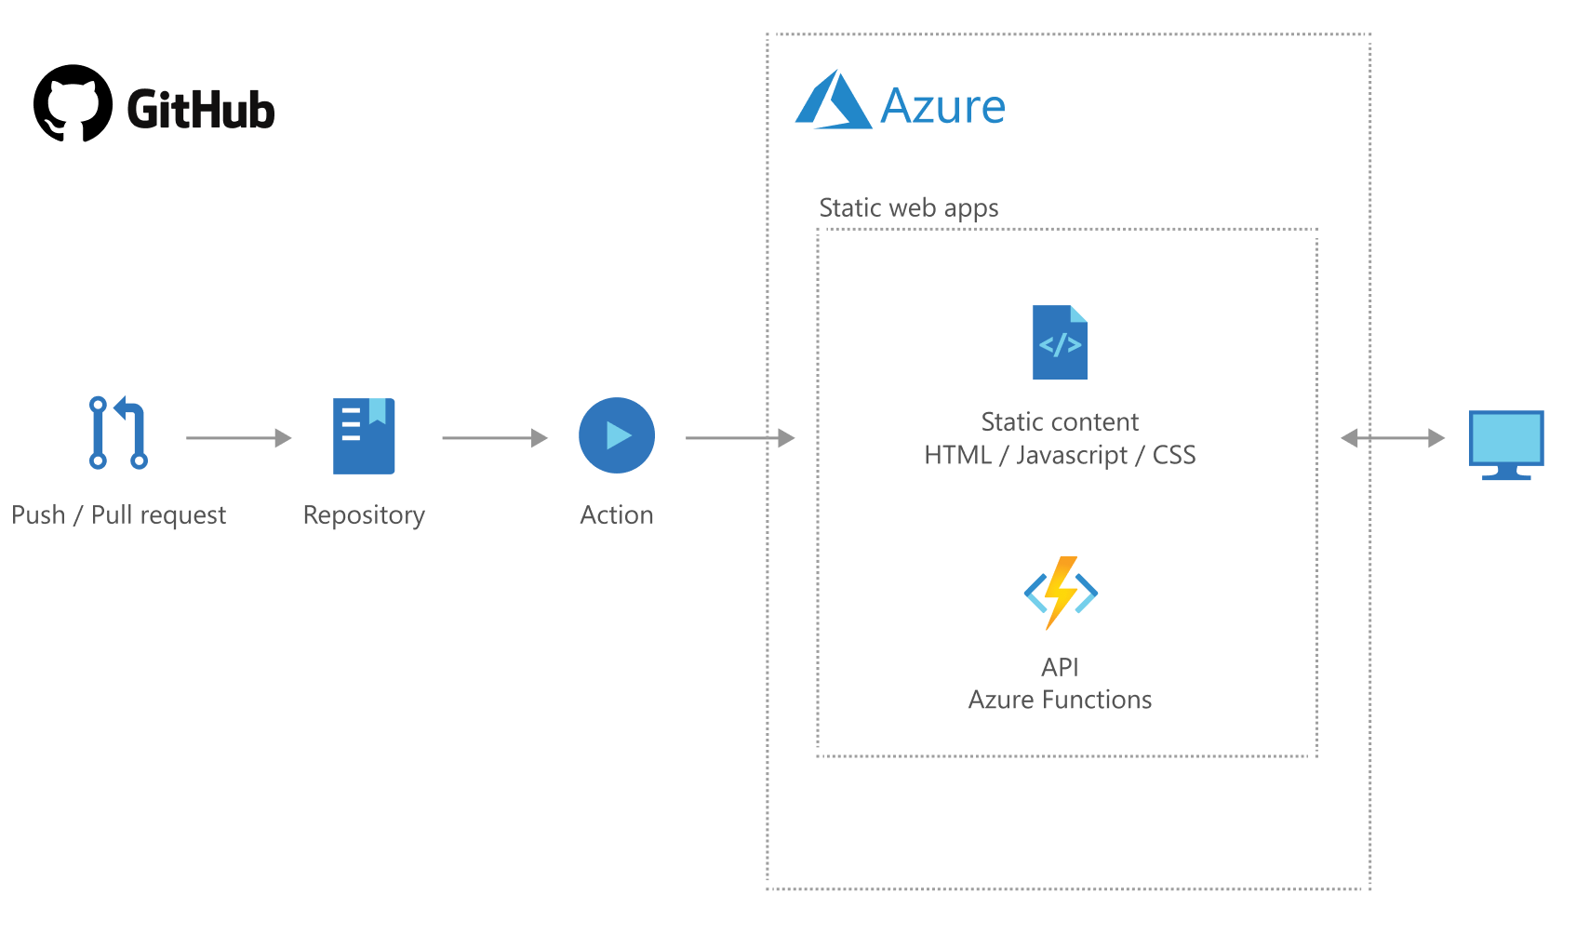
What are Azure Static Web Apps?

Slide 8
Demo
Azure Static Web Apps

Slide 9
API support
Azure Static Web Apps provides serverless API endpoints via Azure Functions
Limitations –
The API route prefix must be api
API must be a JavaScript, TypeScript, Python or C# Azure Function App
Route rules for API functions only support redirects and securing routes with roles
Only HTTP triggers are supported
Logs are only available with Application Insights

Slide 10
Routing
Routes for the static content and api are defined as an array of rules in routes.json file
routes.json file must exist at the root of the build artifact directory
Framework / Library | Location
Angular | assets
React | public
Svelte | public
Vue | public
Blazor | wwwroot

Slide 11
Routing
Routes in static web apps lets you define two things:
Back-end routing rules
Authorization roles
Rules are executed in the sequence as they appear in the array
Each rule supports one or more following properties:
Route Property | Description
route | The route pattern requested by the caller
serve | File or path returned from the request
allowedRoles | An array of role names
statusCode | The HTTP status code response for the request

Slide 12
Authentication and Authorization
Use Invitations to associate users with roles and authorize users to routes based on rules defined in routes.json
Following providers are supported:
Azure Active Directory
GitHub
Facebook
Google
Twitter
Two built-in authorization roles:
anonymous
authenticated
User information can be accessed in Azure Static Web apps (/.auth/me)

Slide 13
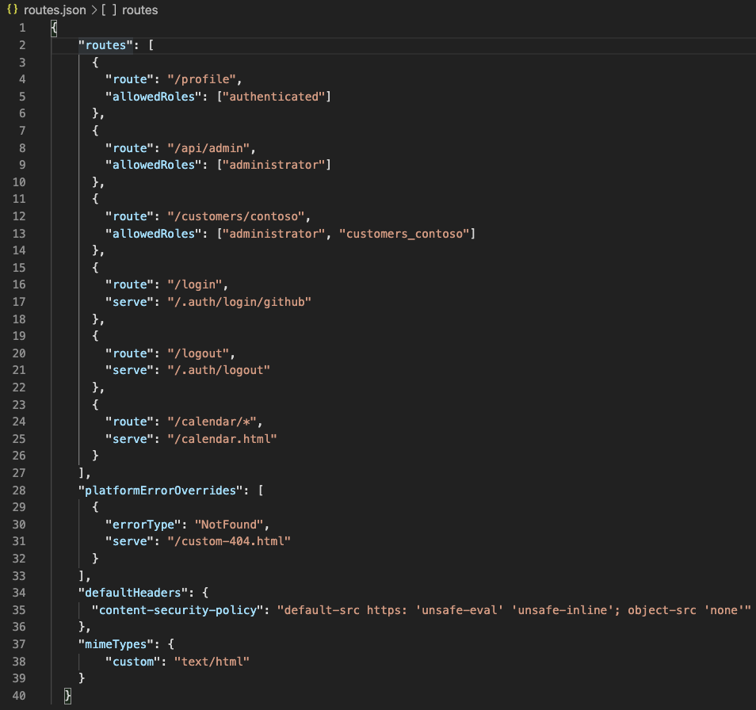
routes.json

Slide 14
Environments
Pre-production environments in ASWA provides a full-fledged staging environment
When a pull request is created against a branch that the Actions workflow watches, a pre-production environment is built
Once you merge your pull request, the changes are merged to the production environment
Multiple pre-production environments can co-exist at a time*
Staged versions of your application are currently accessible publicly by their URL, even if your GitHub repository is private.
* - During preview, only one staging environment is allowed

Slide 15
Demo
Azure Static Web Apps

Slide 16
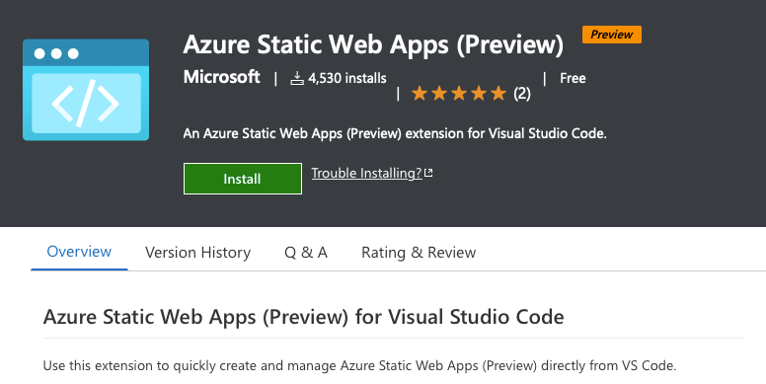
Azure Static Web Apps (Preview) extension for Visual Studio Code
https://aka.ms/savscode

Slide 17
References
Azure Static Web Apps Documentation: https://docs.microsoft.com/en-us/azure/static-web-apps/
GitHub starter: https://github.com/staticwebdev/blazor-starter/generate
Blazor: https://dotnet.microsoft.com/apps/aspnet/web-apps/blazor
Blazor and C# APIs - https://docs.microsoft.com/en-us/azure/static-web-apps/deploy-blazor
GitHub Actions: https://docs.github.com/en/actions
Visual Studio Code extension - https://aka.ms/savscode

Slide 18

Thanks for joining!

